Slide 1
CLOUD BASED EHR SYSTEM
Guidance
Project Guide - Prof. G. A. Patil
Project Coordinator - Prof. R. J. Dhanal
Roll no.
54
55
56
57
47
Batch – B4
Name
Ruturaj Desai
Ruturaj Sawant
Siddhi Jadhav
Rushikesh More
Karan Kenjale
Group – G12

Slide 2
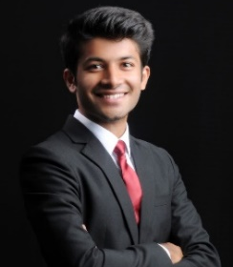

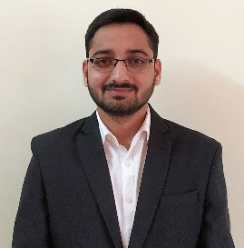
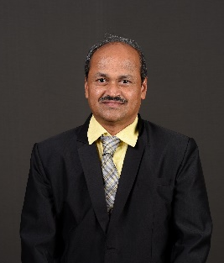
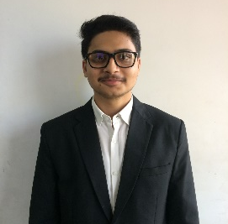
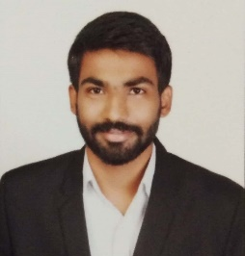
Our Team
Mr. Ruturaj Hemant Desai Mr. Ruturaj Ravindra Sawant Mr. Siddhi Ashok Jadhav
Project Guide
Prof. G. A. Patil
Mr. Rushikesh Ravindra More Mr. Karan Dattatray Kenjale

Slide 3


Experience our system
Scan for a system demo
Scan to use the system

Slide 4
Introduction
An electronic health record (EHR) is more than a digital version of a patient’s paper chart. EHRs are real-time, patient-centred records that make information available instantly and securely to authorized users. While an EHR does contain the medical and treatment histories of patients, an EHR system is built to go beyond standard clinical data collected in a provider’s office and can be inclusive of a broader view of a patient’s care. In our work, we are going to build a centralized cloud-based storage system backed with authorization for user of the system, thus making it convenient for both the patient and hospital to handle their respective clinical data.

Slide 5
Need of the work
Patient Inconvenience
Inconvenience for Hospitals
Diagnostics & Patient Outcomes
Care Coordination
Practice Efficiencies and Cost Savings

Slide 6
Problem Statement
Provide a centralized system to securely store and manage Electronic Health Records ensuring quality, safety, efﬁciency, privacy, and facilitate analysis.
Objectives
To implement EHR based system.
To implement and organize centralized cloud, which can be shared among different health organization.
Provide a secure way to save and access of patient information.
Provide access to authorized users only.
To improve Patient Care.
To improve Care Coordination.
To improve Diagnostics & Patient Outcomes.

Slide 7
Project Code Walk through…

Slide 8
Live Demo!

Slide 9
System Testing

Slide 10
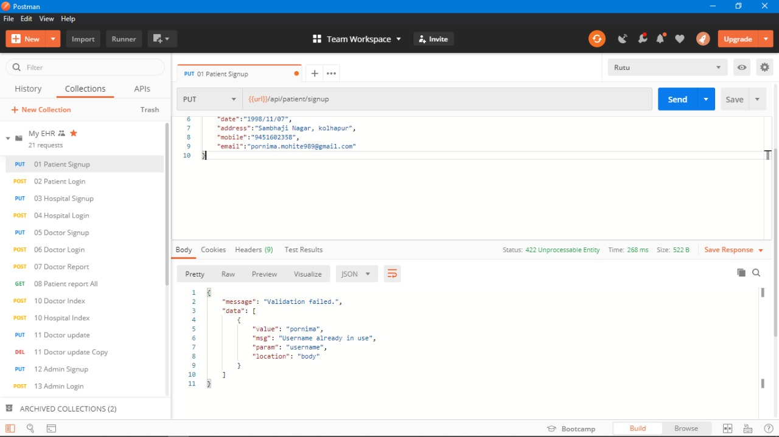

Slide 11
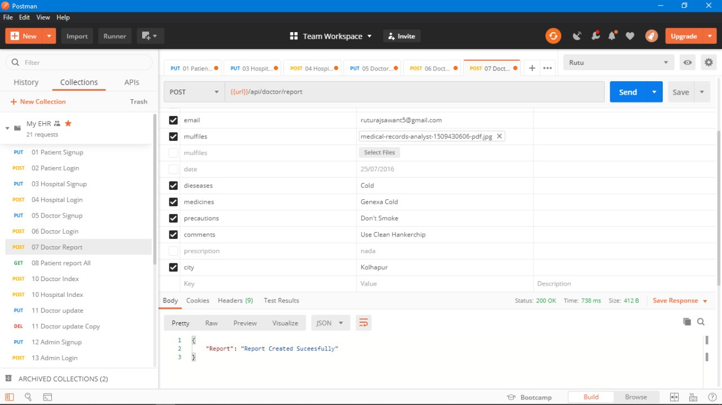
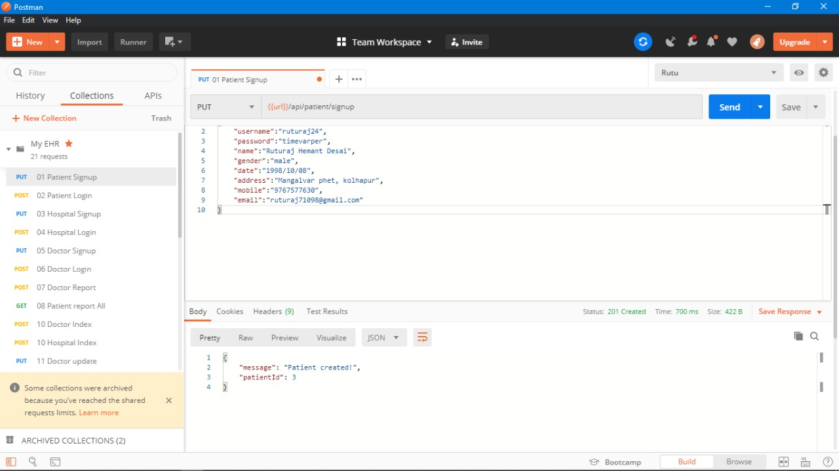
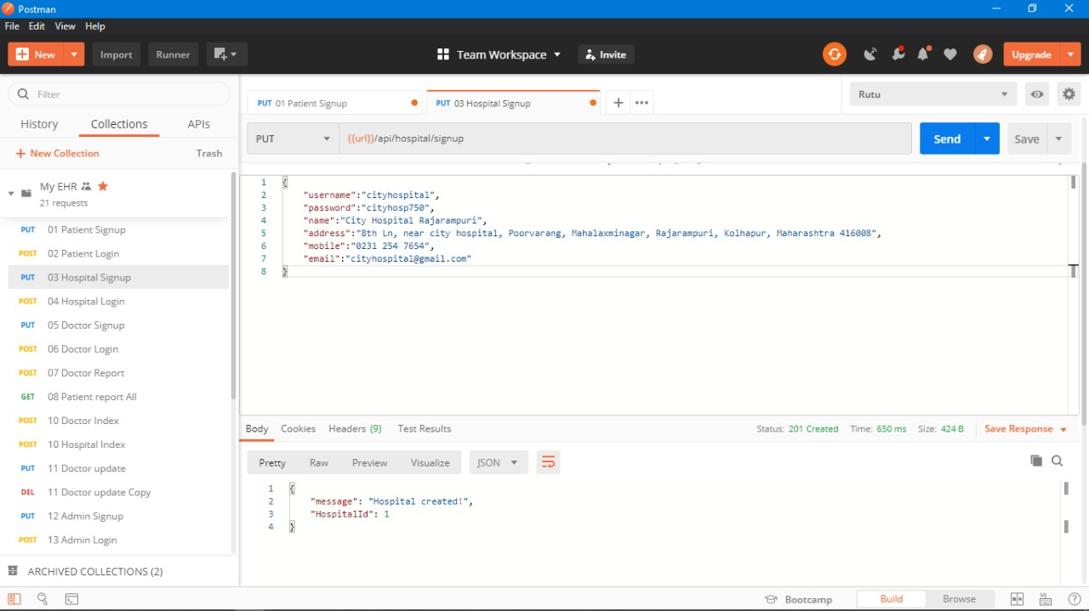
Testing

Slide 14
Technologies used
HTML
CSS
JavaScript
ReactJS
NodeJS
ExpressJS
MySQL

Slide 15
Work done so far
Hospital visits
Information gathering and analysis
Database design
DFD’s
Level 0
Level 1
User Interface
Validation
Implementation
Deploying
Testing
Maintenance

Slide 16
Current Work & Future Plans
App Design
App Development
App Testing
Improving web interface
Improving system efficiency
Feature addition
Real time distribution
Manifesting this current project into a real-life consumer service.

Slide 17
References
Links:
https://www.ijitee.org/
http:/www.researchgate.net/
Paper:
2018 IEEE 11th International Conference on Cloud Computing. Attribute Based Encryption for Secure Access to Cloud Based EHR Systems. Maithilee Joshi, Karuna P. Joshi and Tim Finin University of Maryland, Baltimore ,County, Baltimore, MD 21250, USA.

Slide 18
THANK YOU & BE SAFE…

